Slide 1

ECS 351L and 851L : Geospatial Data Science
Lecture 5: Machine learning fundamentals
Email: jonathan.ryan@duke.edu
Office: 3101 Grainger Hall
Office hours: Mondays and Wednesdays 15:00-16:00

Slide 2
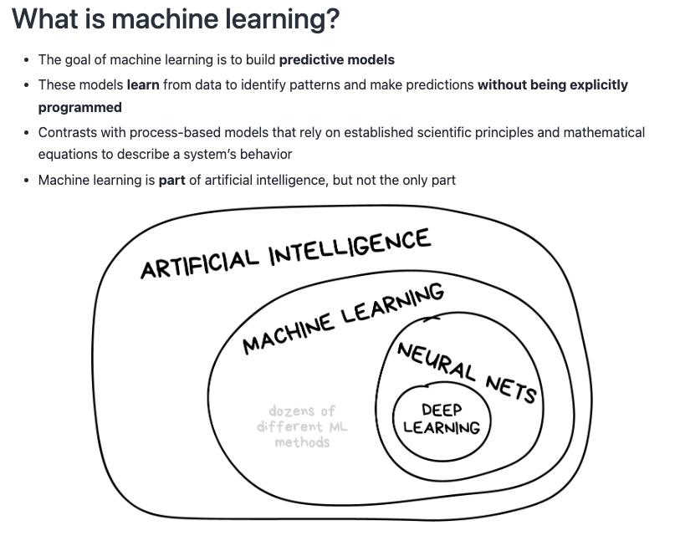

Slide 3
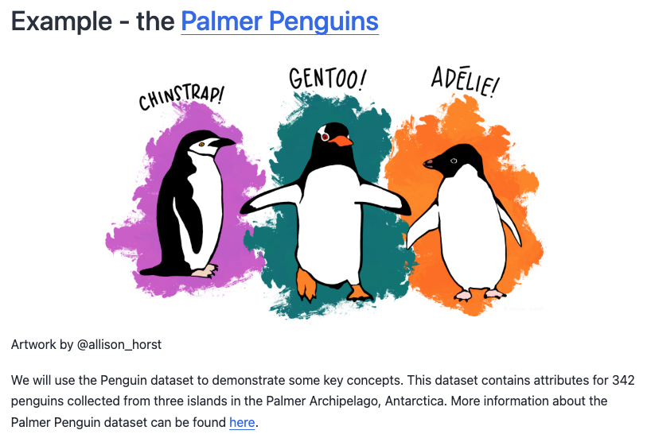

Slide 4
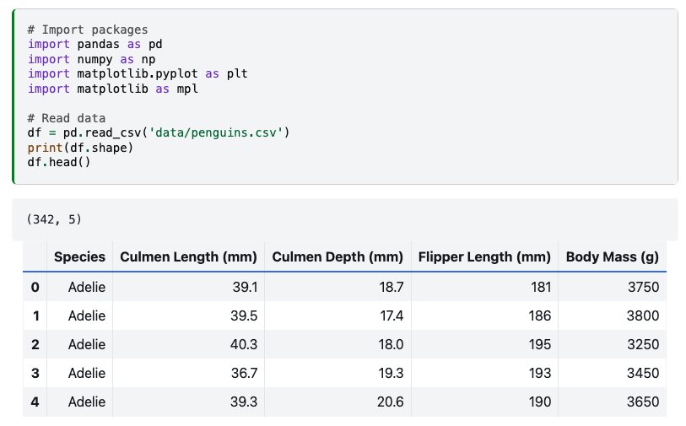

Slide 5
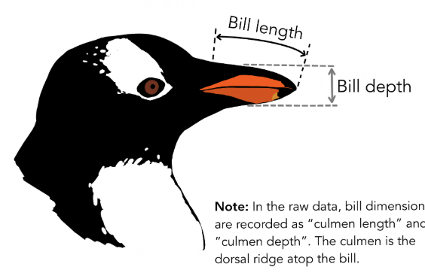

Slide 6
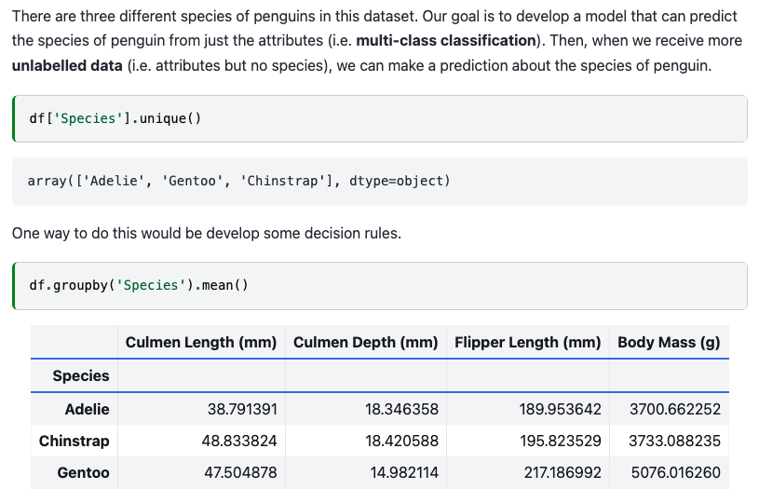

Slide 8
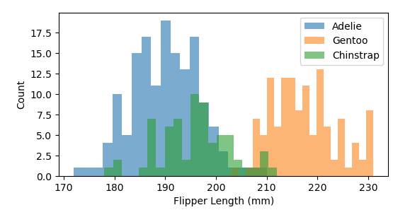
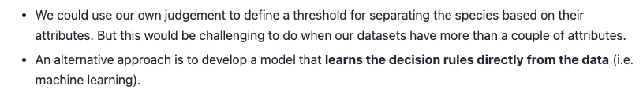

Slide 9
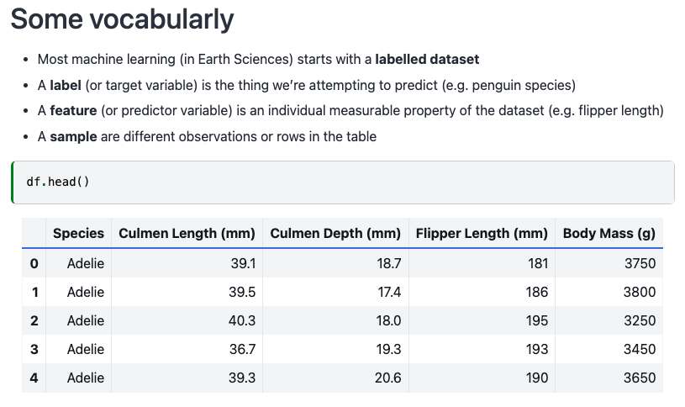

Slide 10
Sample
Label
Features

Slide 11
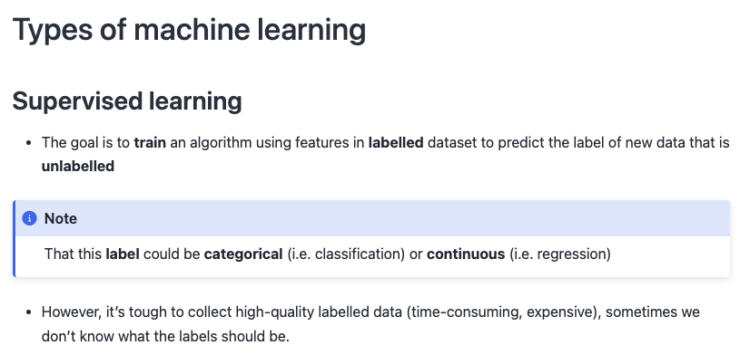
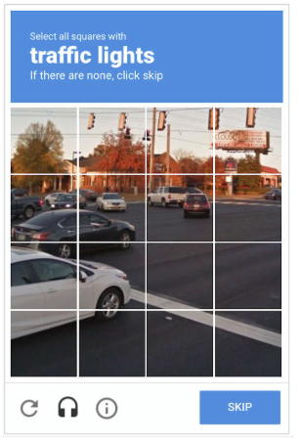

Slide 12
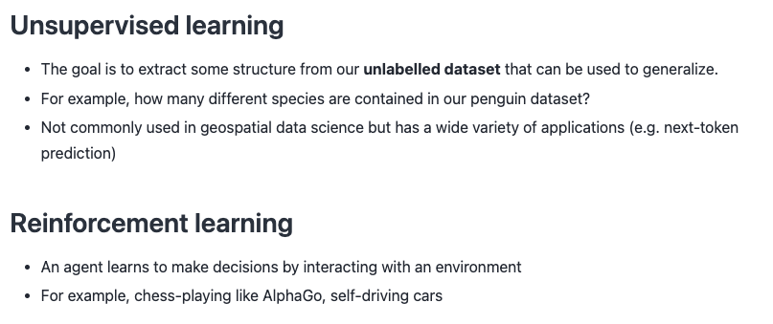

Slide 14
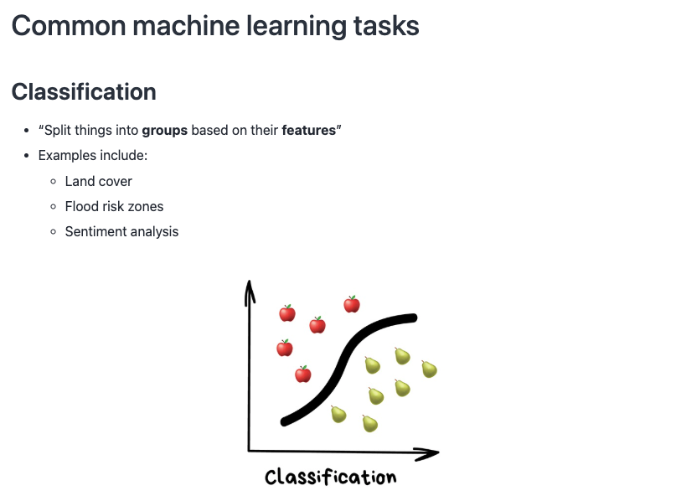

Slide 15
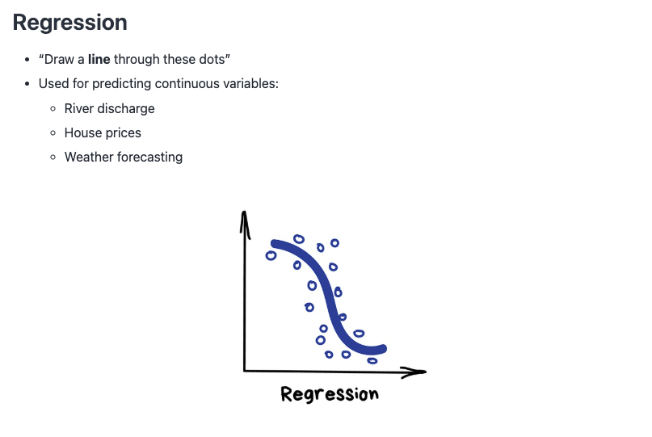

Slide 16
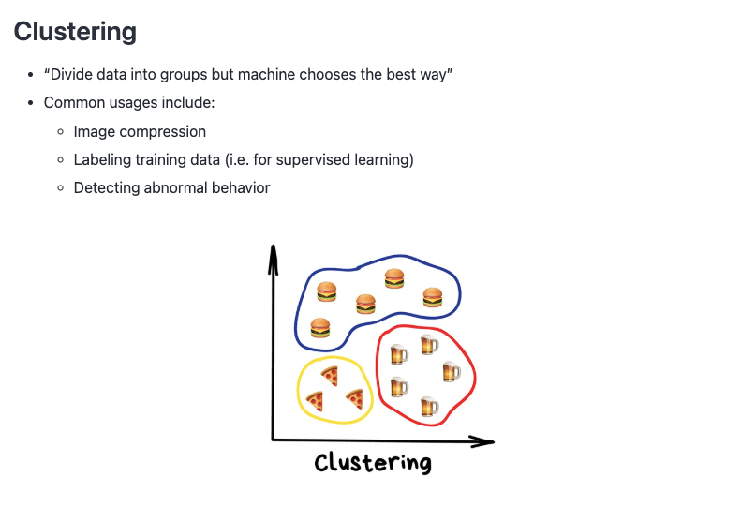

Slide 17
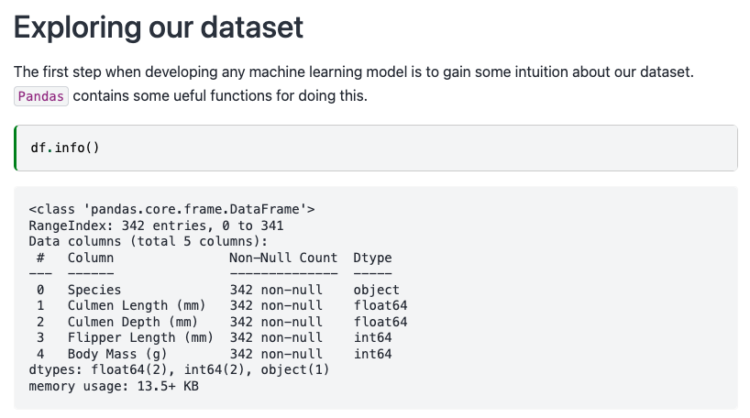

Slide 18
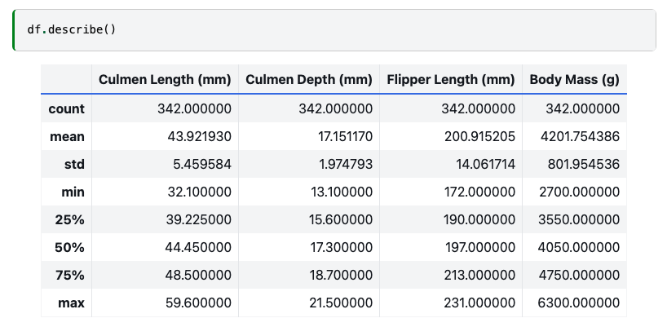

Slide 19
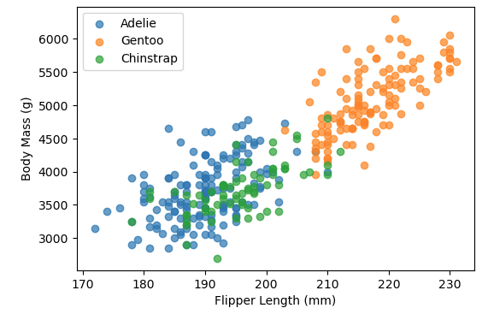

Slide 20
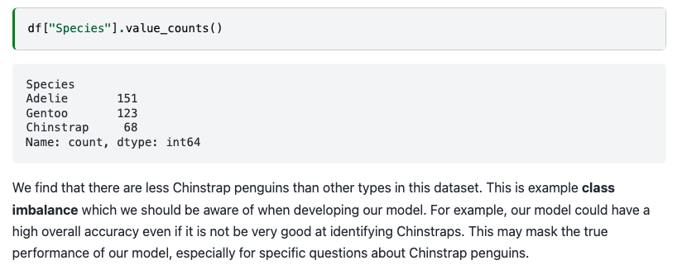

Slide 21
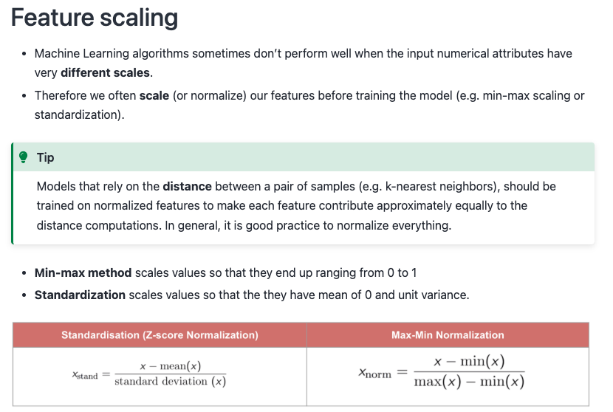

Slide 24
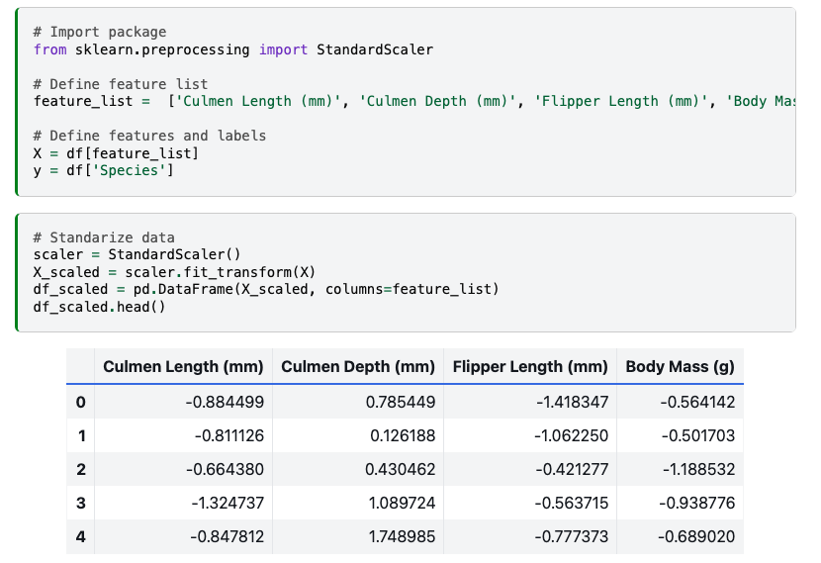

Slide 25
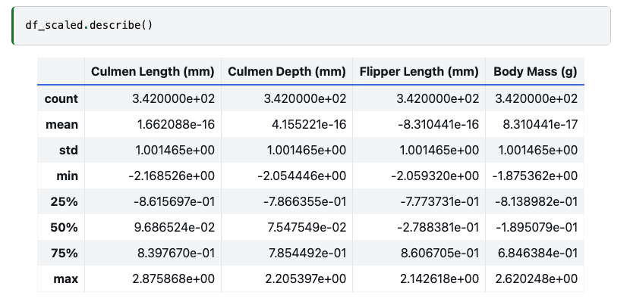

Slide 26
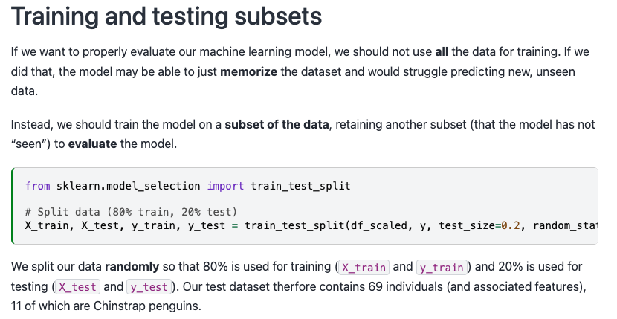

Slide 27
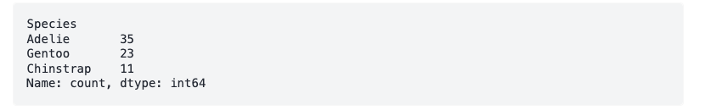

Slide 28
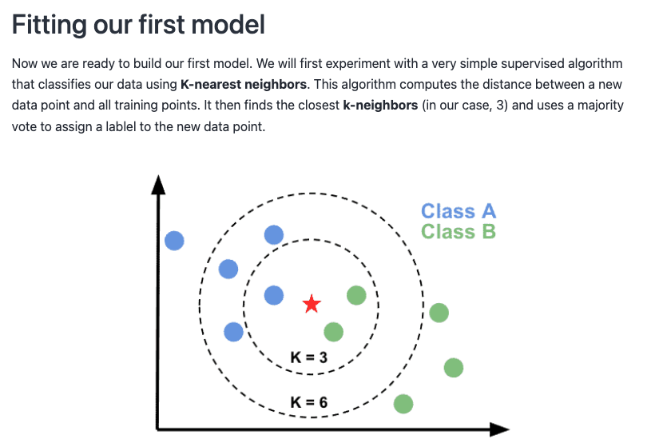

Slide 29
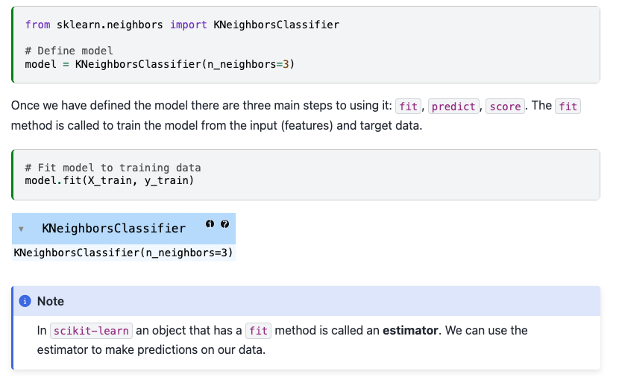

Slide 32
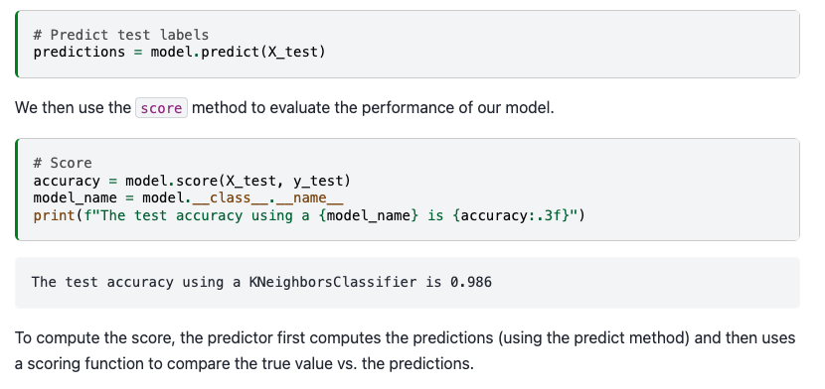

Slide 33
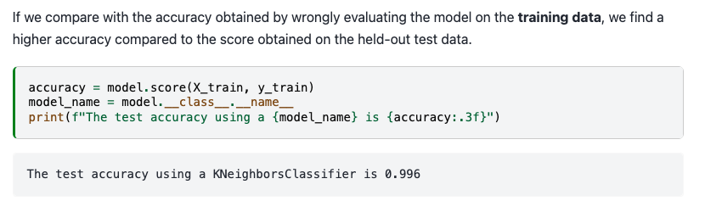

Slide 34
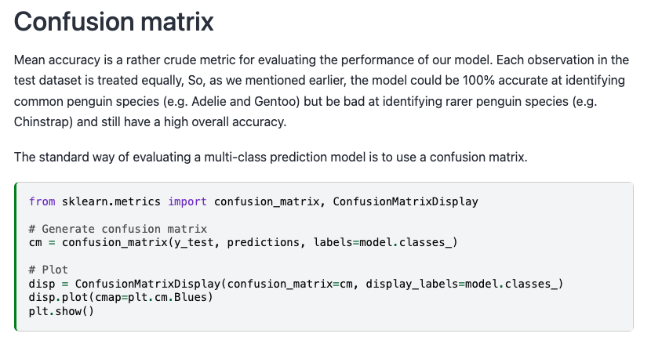

Slide 35
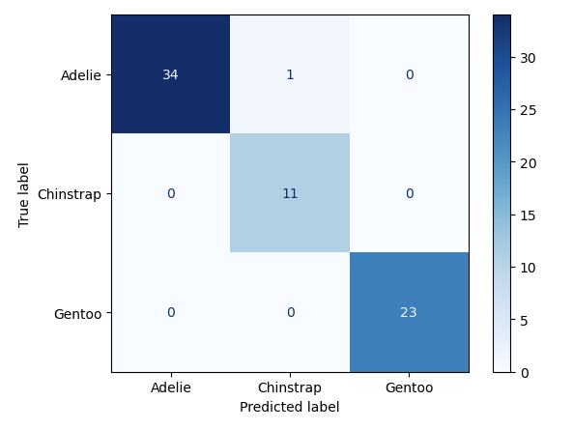

Slide 36
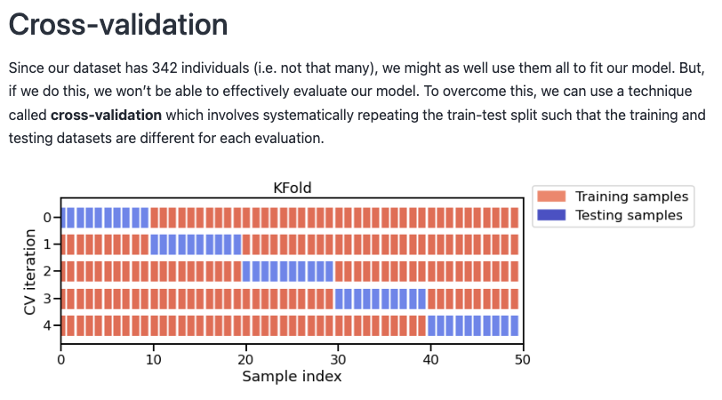

Slide 37
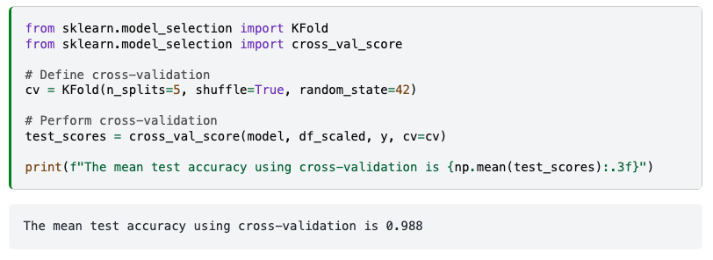

Slide 38
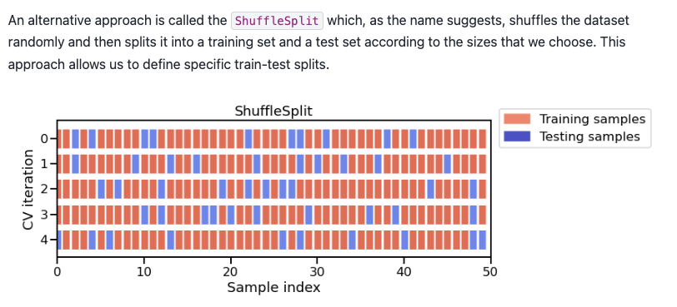

Slide 39
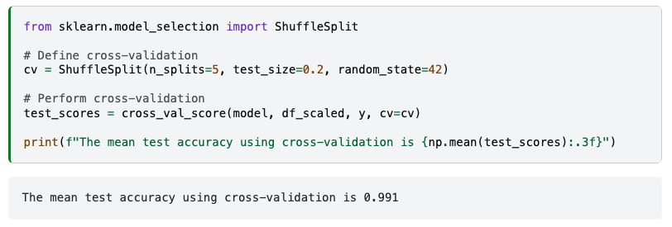

Slide 40
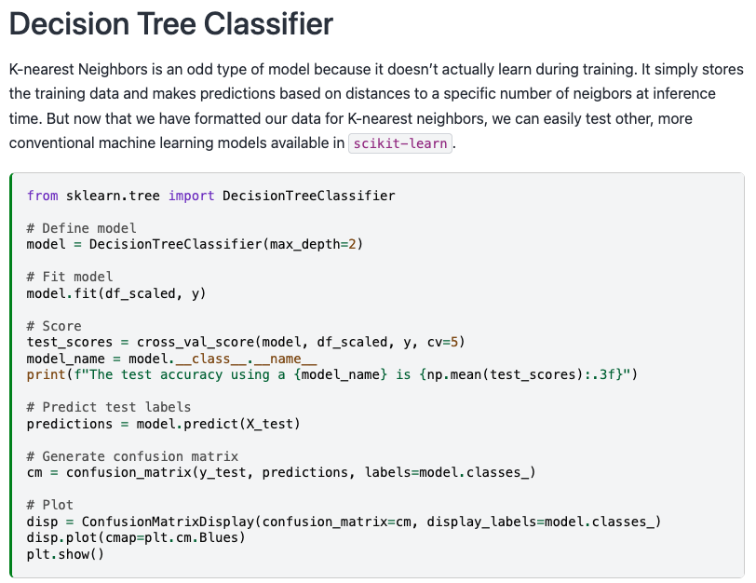

Slide 41
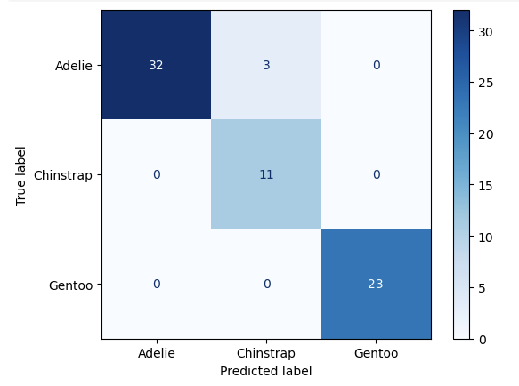

Slide 42
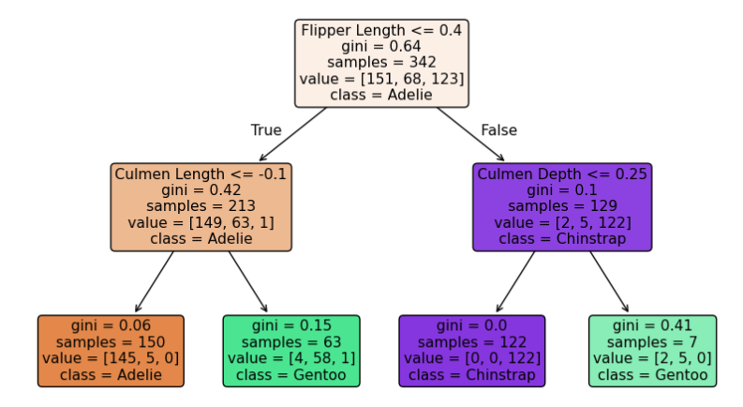
Notes:
The attribute (e.g. Flipper Length) can be positive or negative because we standardized the values.

Slide 43
Notes:
The attribute (e.g. Flipper Length) can be positive or negative because we standardized the values.

Slide 44
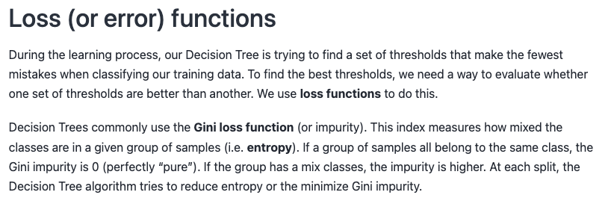
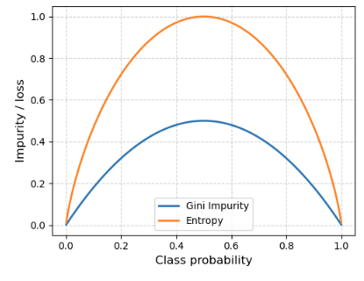

Slide 45
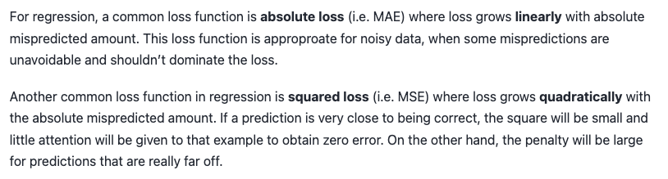
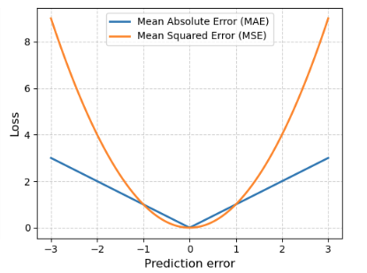

Slide 46
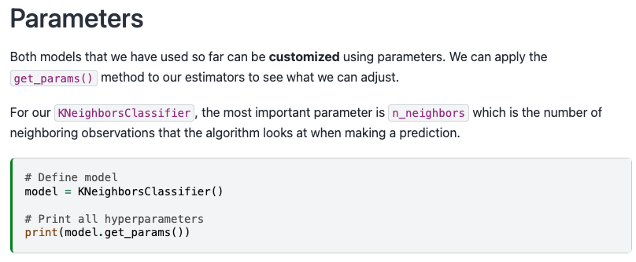
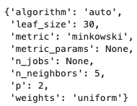

Slide 47
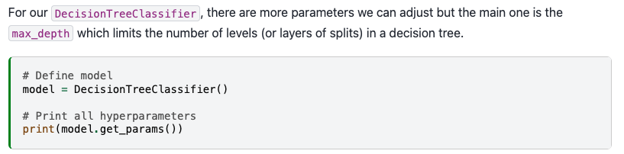
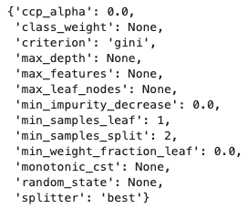

Slide 48
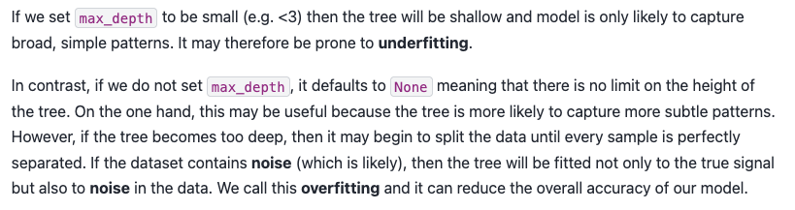
Notes:
Machine learning models tend to be very flexible meaning that they are great at finding complex, non-linear patterns in data. The cost of such flexibility is that they will memorize or overfit the training data if not properly developed. Preventing them doing this is therefore possibly the greatest challenge in machine learning research.

Slide 49
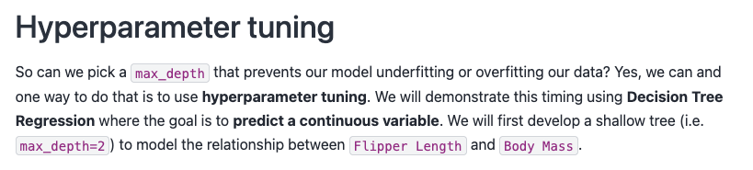
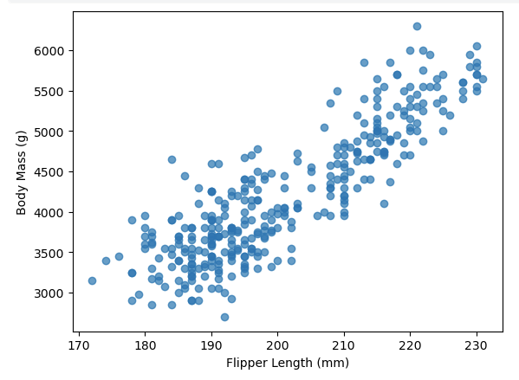

Slide 50
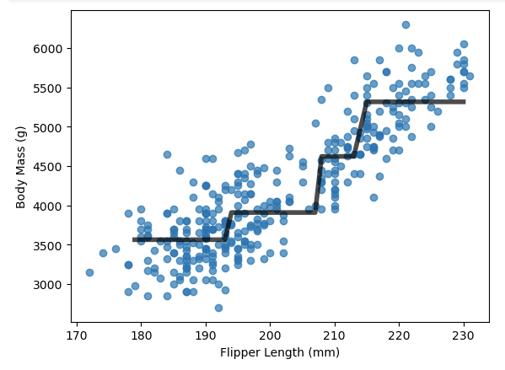
Max depth = 2

Slide 51
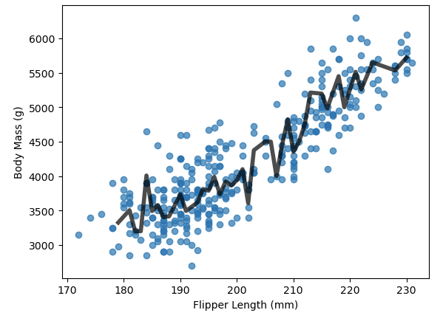
Max depth = None
Notes:
Our “unconstrained” Decision Tree developed a very deep tree with 10 levels.

Slide 52
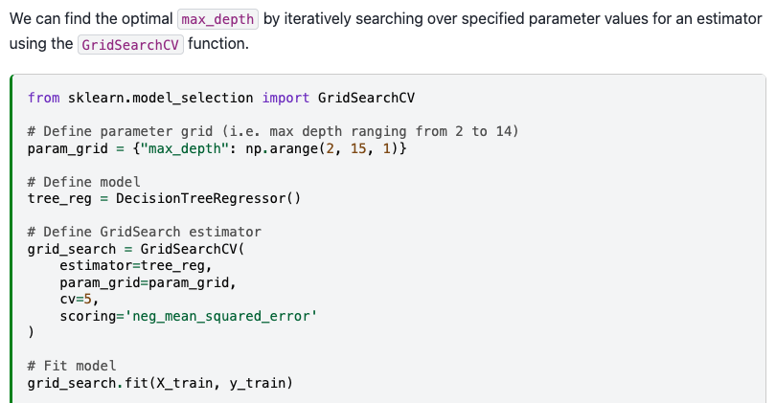

Slide 53


Slide 54

Max depth = 3

Slide 55


Slide 56


Slide 57


Slide 59


Slide 60

Notes:
For max_depth < 10, the decision tree underfits the data. The training error and therefore the testing error are both high because the model is too constrained and cannot capture much of the variability of in house prices.
The decision tree generalizes the best at max_depth = 10. It is flexible enough to capture a fraction of the variability of the target that generalizes, while not memorizing all of the noise in the target.
The decision tree overfits for max_depth > 10. The training error becomes very small, while the testing error actually increases. At these max_depths, the model is memorizing the dataset, including the noise, which is harming its ability to generalize to the test data.

Slide 61


Slide 63


Slide 64


Slide 65


Slide 66

Notes:
We find that the testing error becomes lower as more samples are added to the training set. It looks as though the testing error is starting to plateau a bit but it is also still going down. We can therefore conclude that more samples would probably improve our predictive model.
This kind of analysis can be useful for informing decision-making. If it is possible to collect more samples, then we should probably do that. If that is not possible, we may consider artificially creating new, modified copies of existing data (i.e. data augmentation).
On the other hand, if the testing error did plateau, then collecting more samples would not be useful and we may reserve our efforts for other things e.g. reducing or handling noise in dataset, developing more sophisticated models etc.

Slide 67


Slide 68



Slide 69


Slide 70


Slide 71


Slide 72


Slide 73

Notes:
Random Forests is a very popular ensemble algorithm. This is partly because it almost always performs better than single models and partly because it is not very sensitive to the choice of hyperparameters. There are really only two hyperparameters to pick, n_estimators which can be as large as you can computationally afford and max_features which determines the number of features to use for each tree. Usually the default value of sqrt(n_features) is appropriate. Furthermore, since decision trees work with features that have different scales or magnitudes, preprocessing is minimal.

Slide 74


Slide 76


Slide 77



Slide 78


Slide 79


Slide 80


Slide 81



Slide 82


Slide 83

Wednesday: Wine activity
Email: jonathan.ryan@duke.edu
Office: 3101 Grainger Hall
Office hours: Mondays and Wednesdays 15:00-16:00

